Slide 1
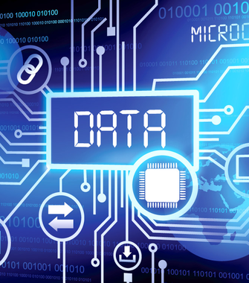
FFAR Project Presentation by Fin Amin and Dr. Lisa Van den Broeck

Slide 2
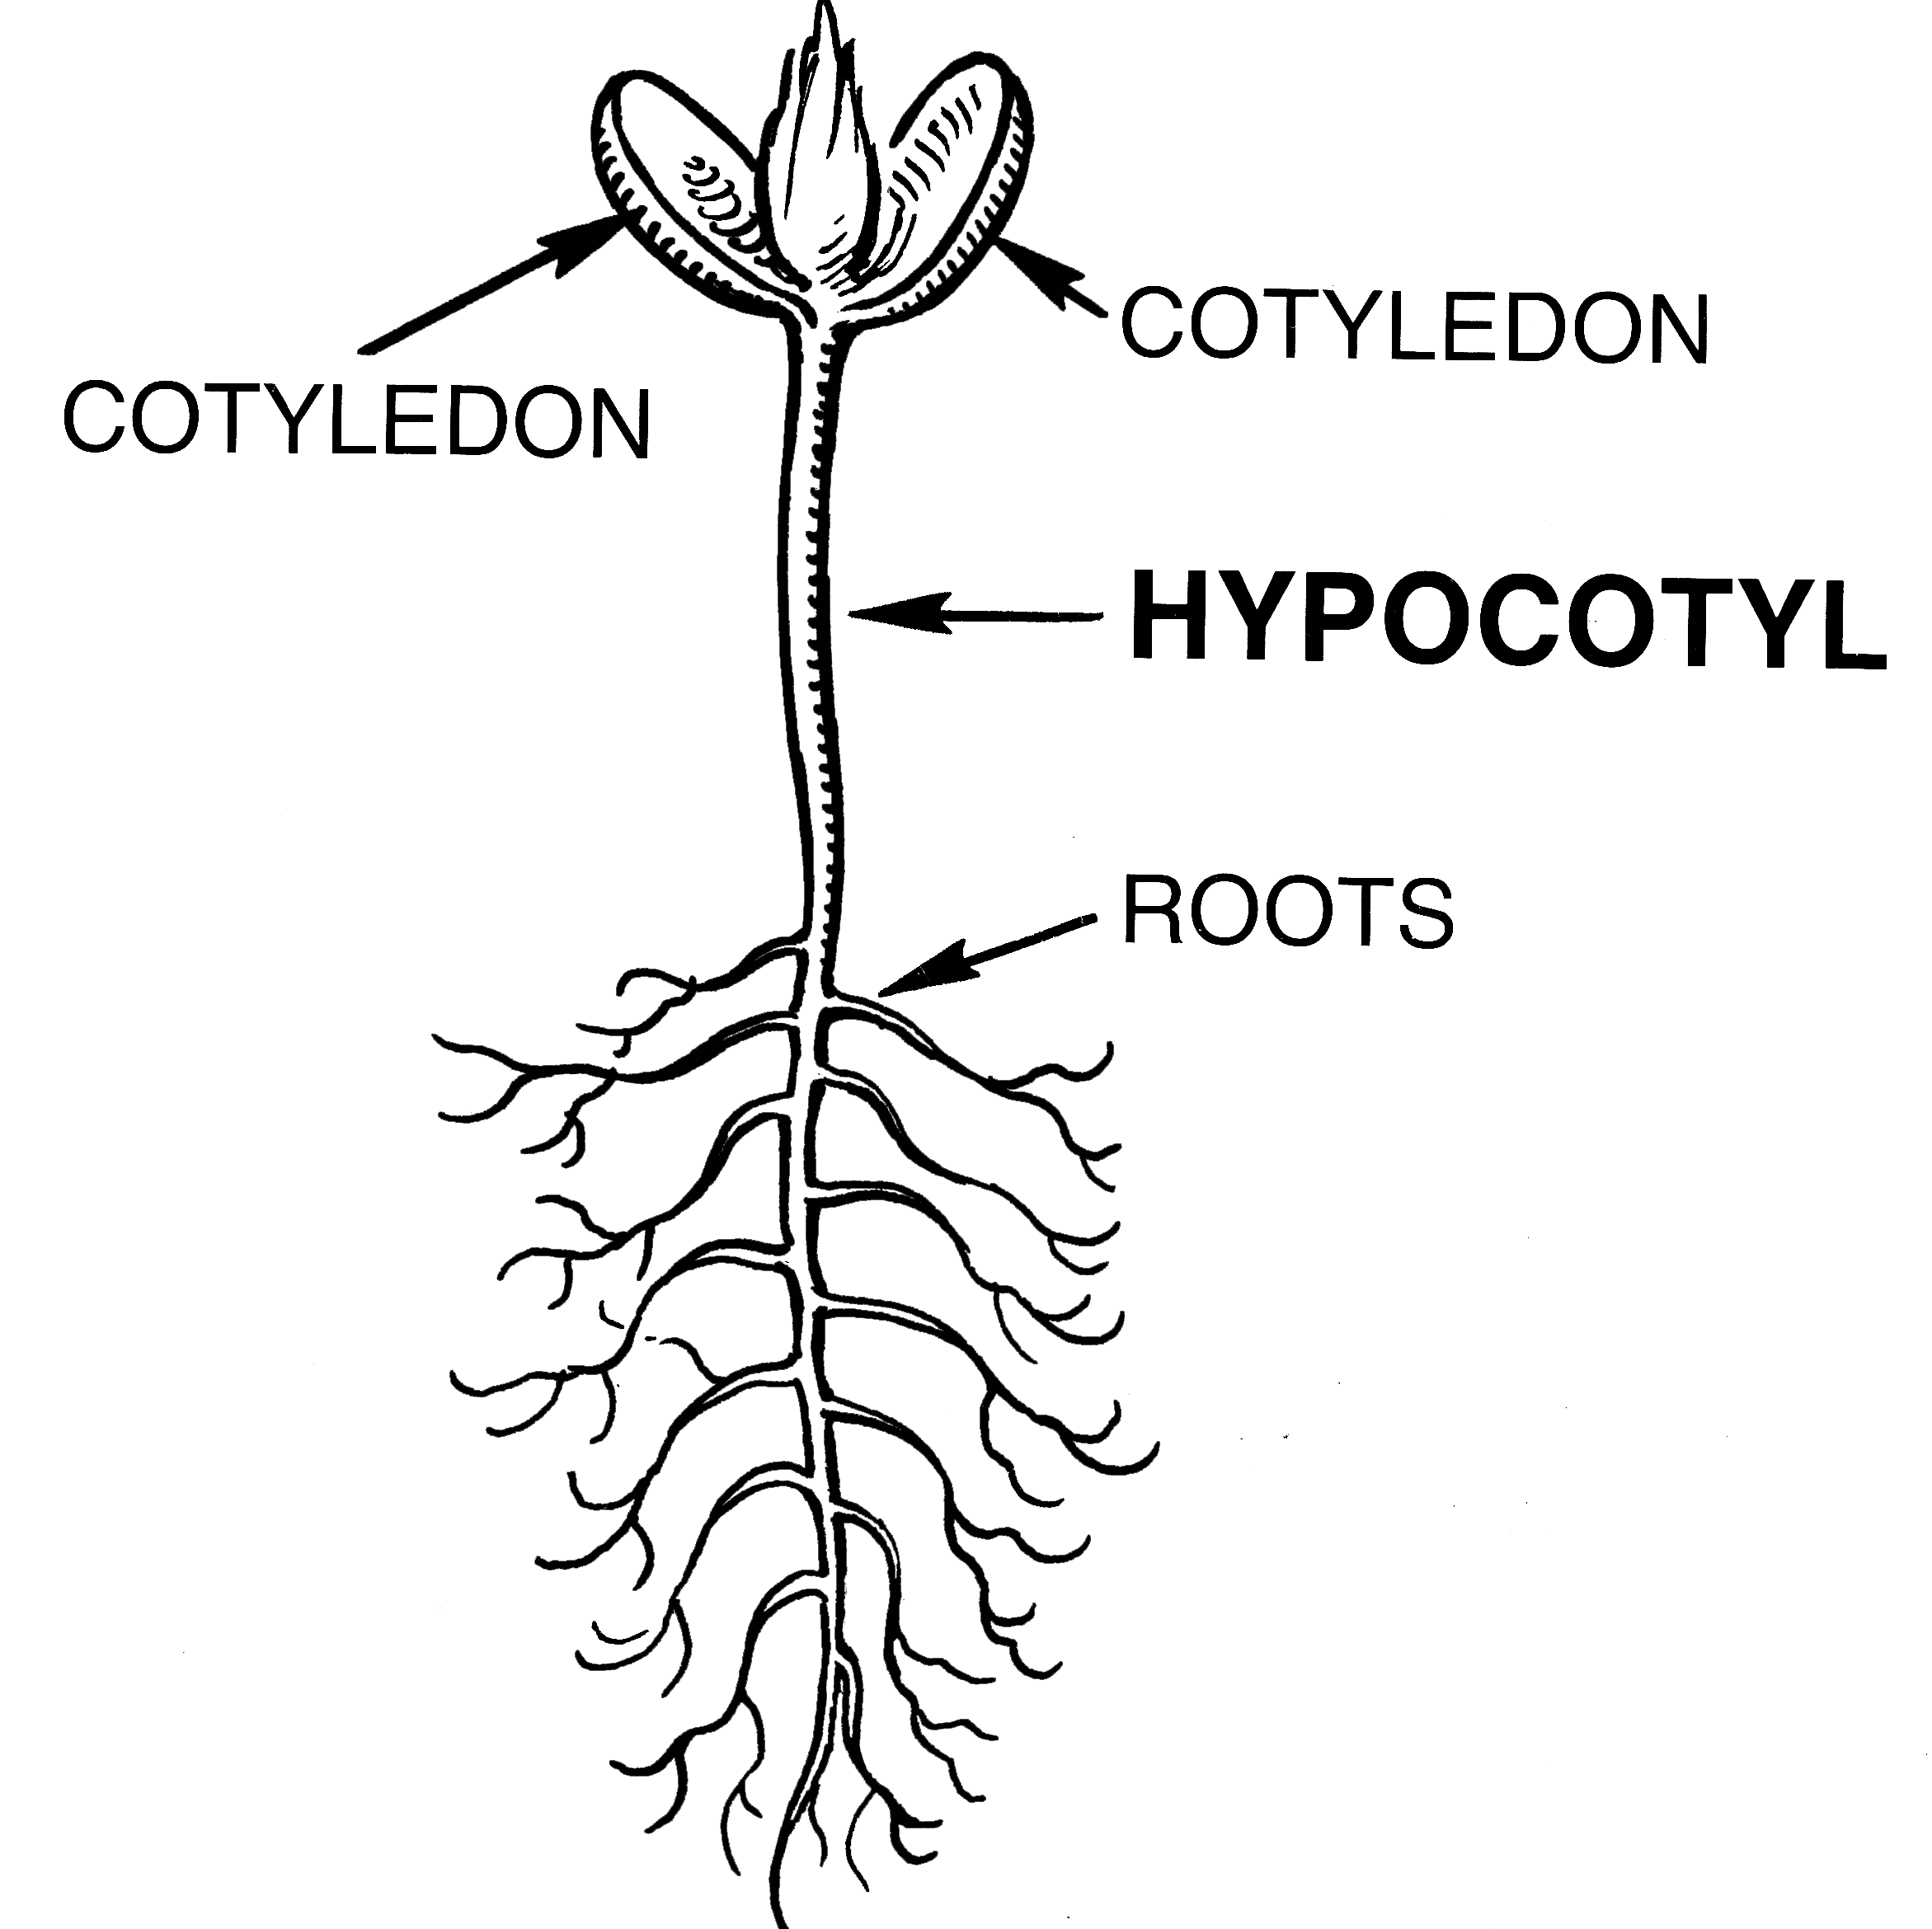
Objective
The goal of this project is to discover the connection between changes in phosphoproteomics and a subsequent phenotype.
An example would be heat stress activating a phosphorylation signaling pathway which induces an adaptive change in certain phenotype(s).
An example of a phenotype changing would be the elongation of the hypocotyl. [1]
Notes:
[1] Author of the image is Pearson Scott Foresman. Taken from Wikipedia—the image is in the public domain.

Slide 3
Prior Work
The phosphorylation signaling cascade was unraveled.
We know the phosphorylation intensities, what regulates what, and the associated phenotype
The dataset has been normalized, ie. each datapoint has had its mean subtracted and has been divided by its standard deviation.
Notes:
Author of the image is Pearson Scott Foresman. Taken from Wikipedia—the image is in the public domain.

Slide 4
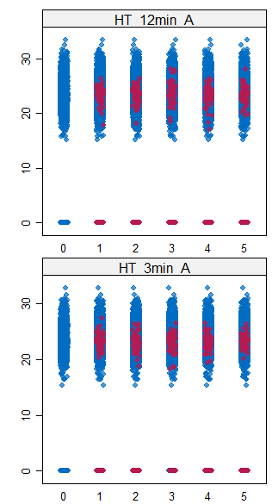
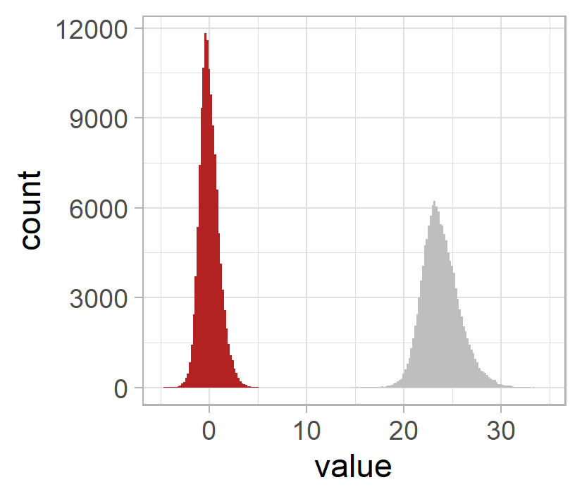
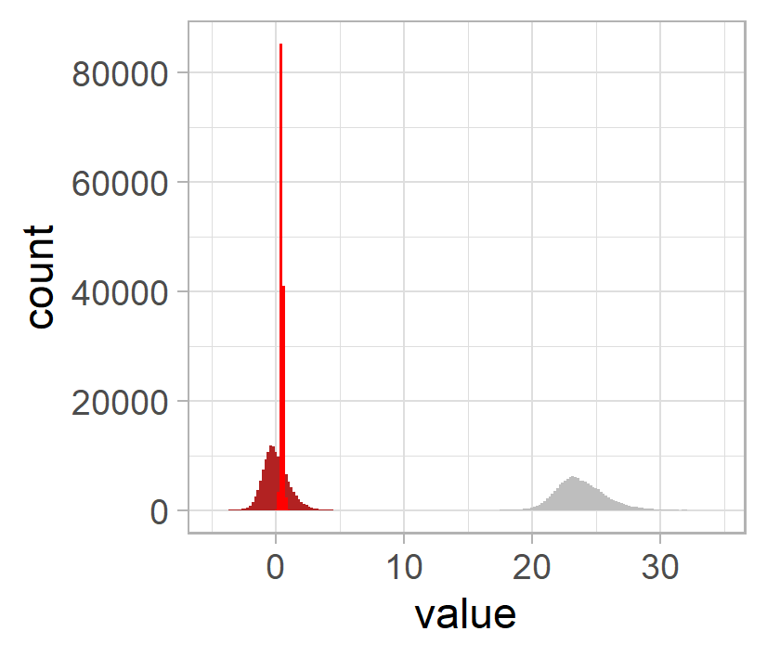
Preparing training data for unsupervised learning
Collect datasets
Data imputation
Preprocessing
Data padding
Normalization
Dataset | # time points (t) | # t after padding
1 | 4 | 6
2 | 4 | 6
3 | 4 | 6
4 | 4 | 6
5 | 6 | 6
6 | 6 | 6
7 | 6 | 6
8 | 6 | 6
9 | 5 | 6
10 | 5 | 6
11 | 5 | 6
12 | 5 | 6
13 | 4 | 6
14 | 4 | 6
26 phospho-proteome datasets from literature and our collaborators
(>50% of our selected phosphopeptides)
Scaling

Slide 5
A brief introduction to auto encoders
Auto encoder
Weights = values assigned to the connections; high weights have an increased importance
The output of the autoencoder should ideally be the input
Compressed data
Encode
Decode
A “summary” of our data
Notes:
Unsupervised with 52 datasets
Check weights first layers
Check latent space --- summarize the data that we have
Supervised with 4 datasets

Slide 6
How am I using auto encoders?
1
2
Analyze the output of the encoder
Train the auto encoder
Initialize the encoder weights with the regulator gene matrix. Then train on the modified dataset.
The output of the encoder contains the most essential details extracted from the phosphopeptides.
The output of the autoencoder should ideally be the input
Compressed data
Encode
Decode
Predict
A “summary” of our data
Notes:
Unsupervised with 52 datasets
Check weights first layers
Check latent space --- summarize the data that we have
Supervised with 4 datasets

Slide 7
Preparing Datasets
For training the auto encoder, we have 6 datasets with different dimensions and different time steps. How do we make the most of what we have?
First, we must train a linear regression model on each dataset. Then there are two potential approaches…

Slide 8
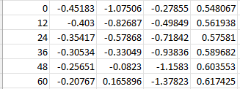
Preparing Datasets
One way is to generate an entirely synthetic dataset using the linear model which matches the dimensionality and time stepping of dataset 1.

Slide 9
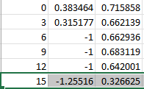
Preparing Datasets
Another way is to interpolate additional time steps within existing datasets to match the dimensionality but not necessarily the time steps of experiment 1.

Slide 10
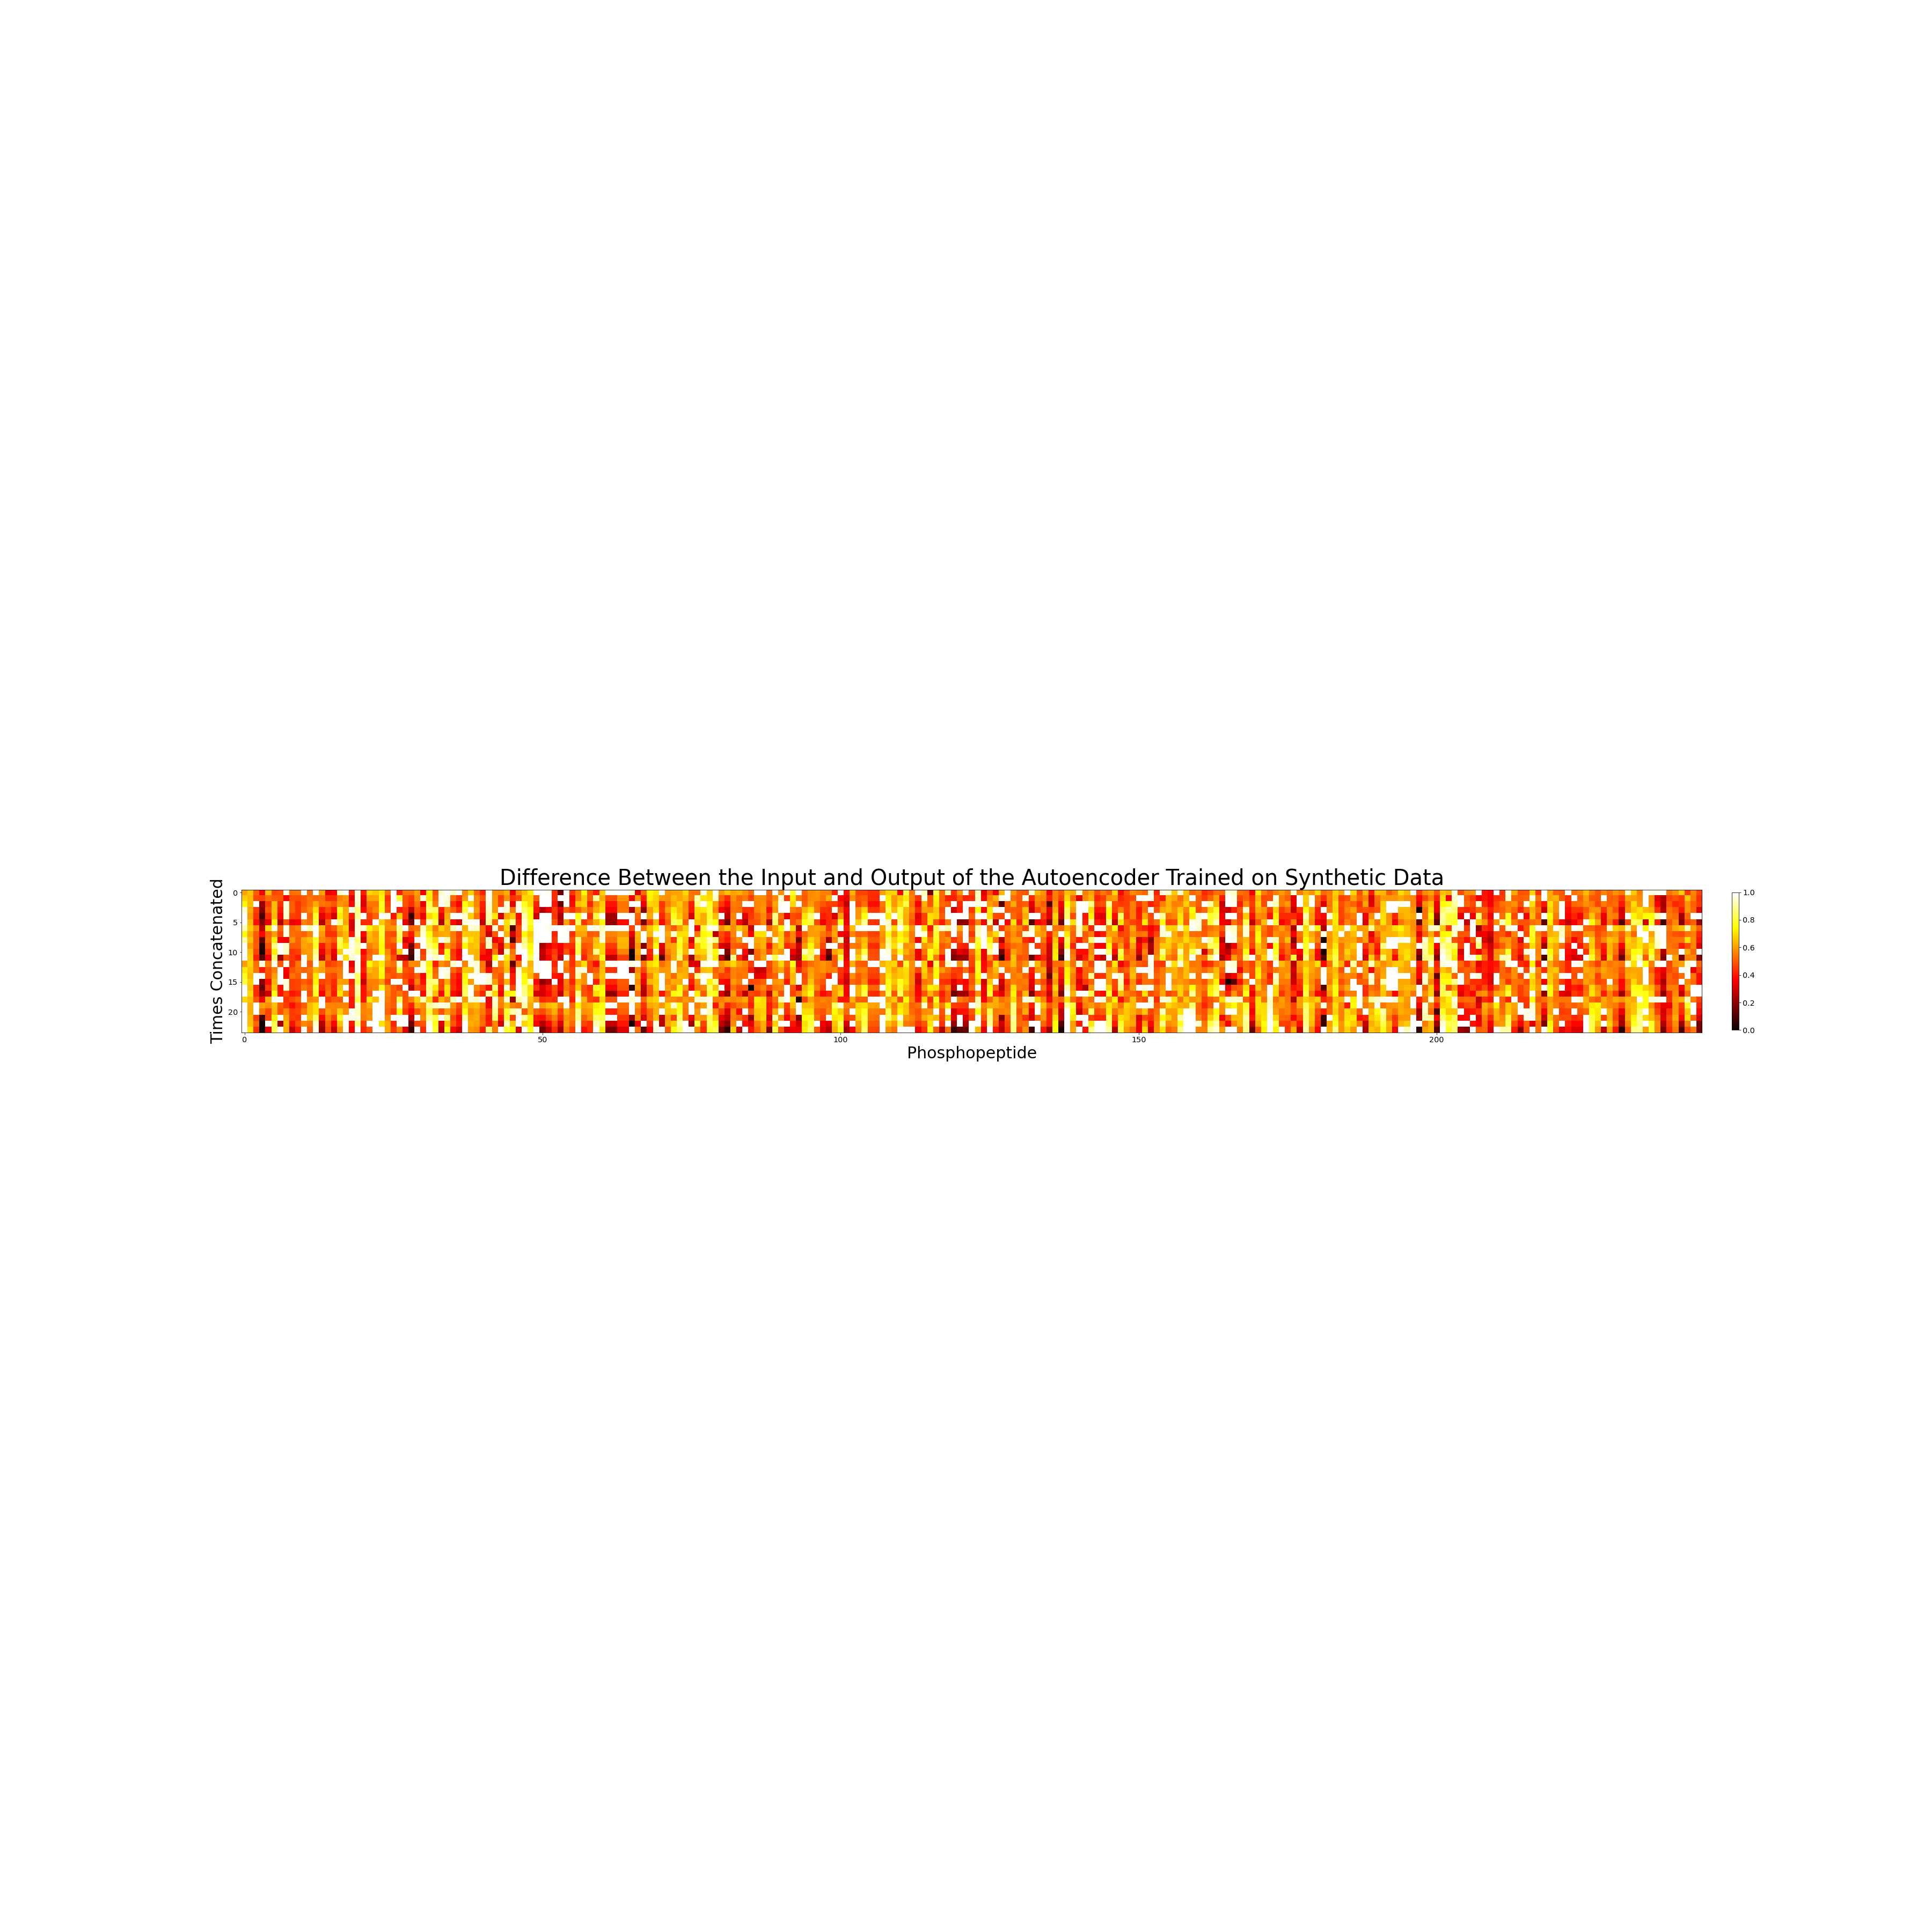
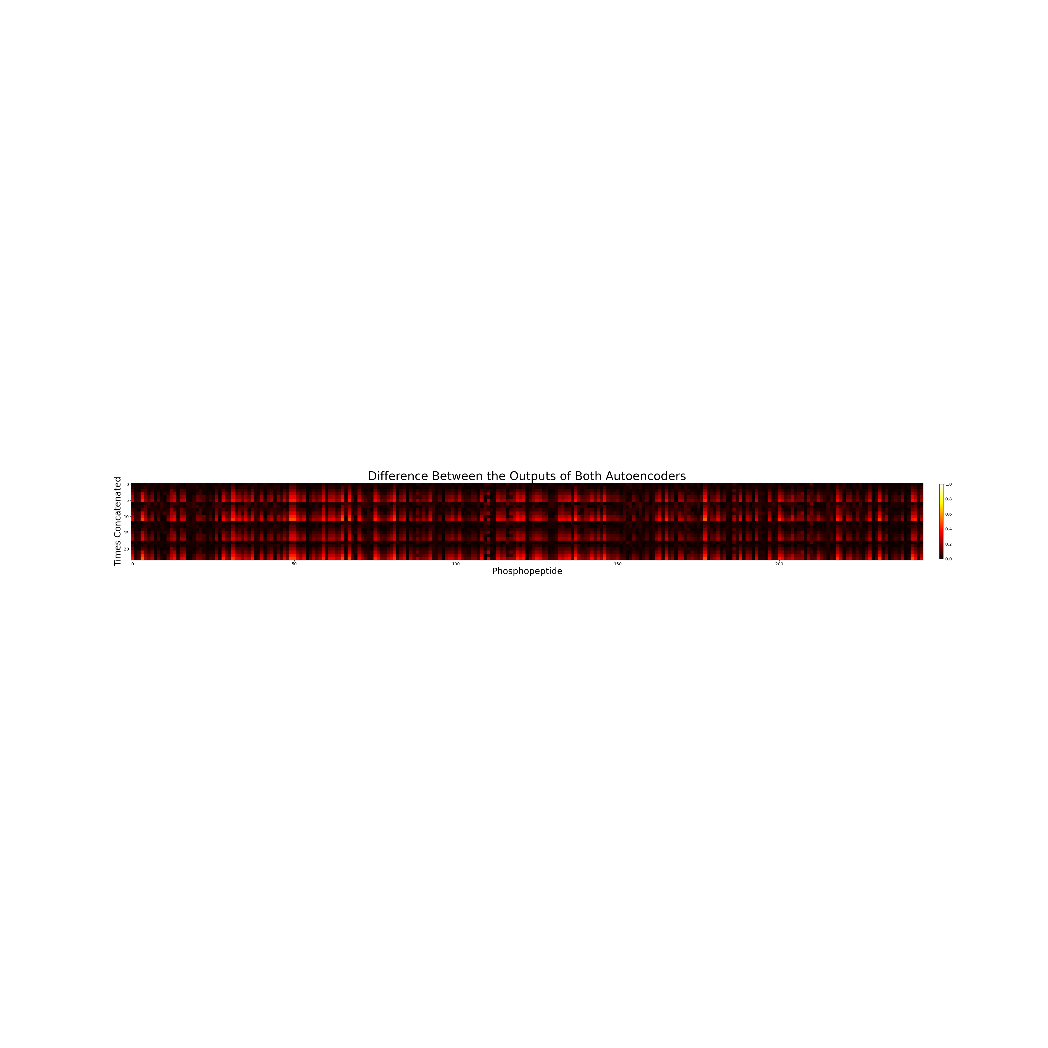
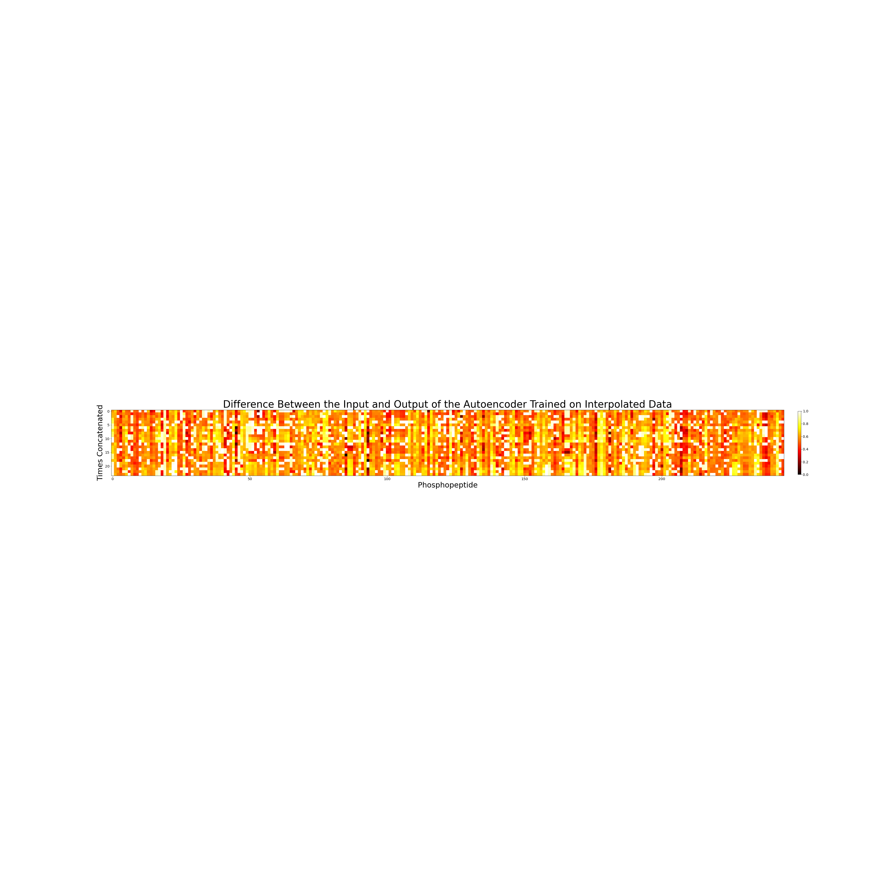
Comparing Auto Encoder Performances
These plots visualize the difference between the input and output of the two different autoencoders—one trained on purely synthetic data, and another trained on interpolated data. The upper-most plot visualizes the difference between their respective outputs.

Slide 11
What’s Next? Feature Extraction and NiMB Chapter Work
The encoder of an autoencoder learns the most important features of the given input. After selecting one of the two autoencoders, the next step is to see what we find at the output of the encoder. Visualizing this information will require unraveling the effects of convolution and a nonlinear activation on the dataset. Doing so will allow us to better understand the latent space generated by the autoencoder. We expect to have this complete by July 10.
I am also working on the network inference portion of the NiMB chapter. We expect to have a draft complete by July 7.
Any questions?

Slide 12
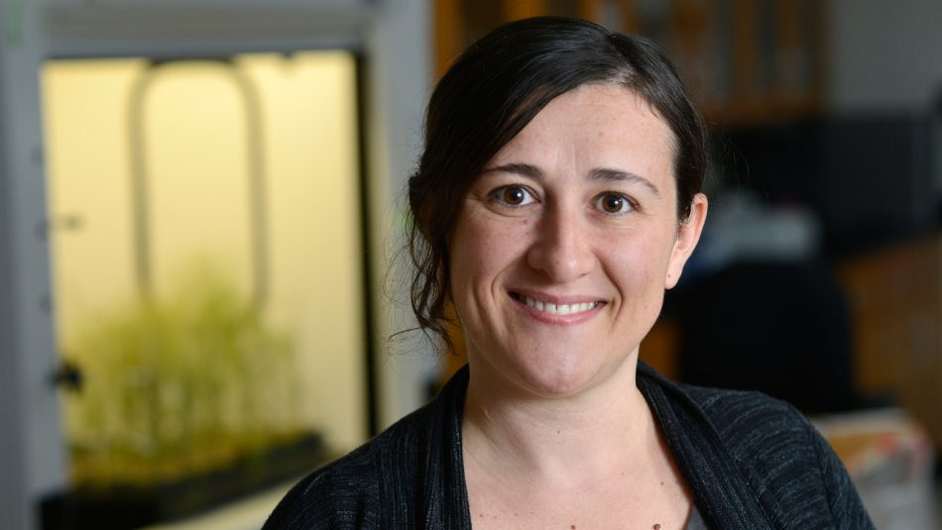

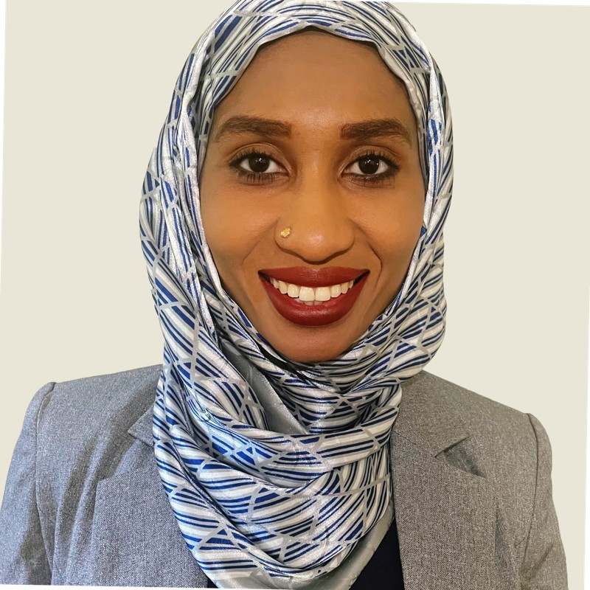
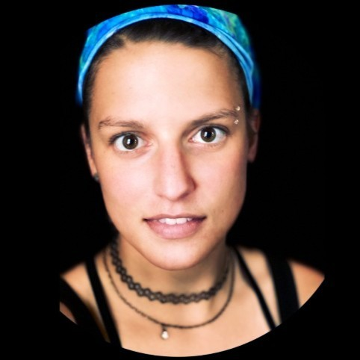
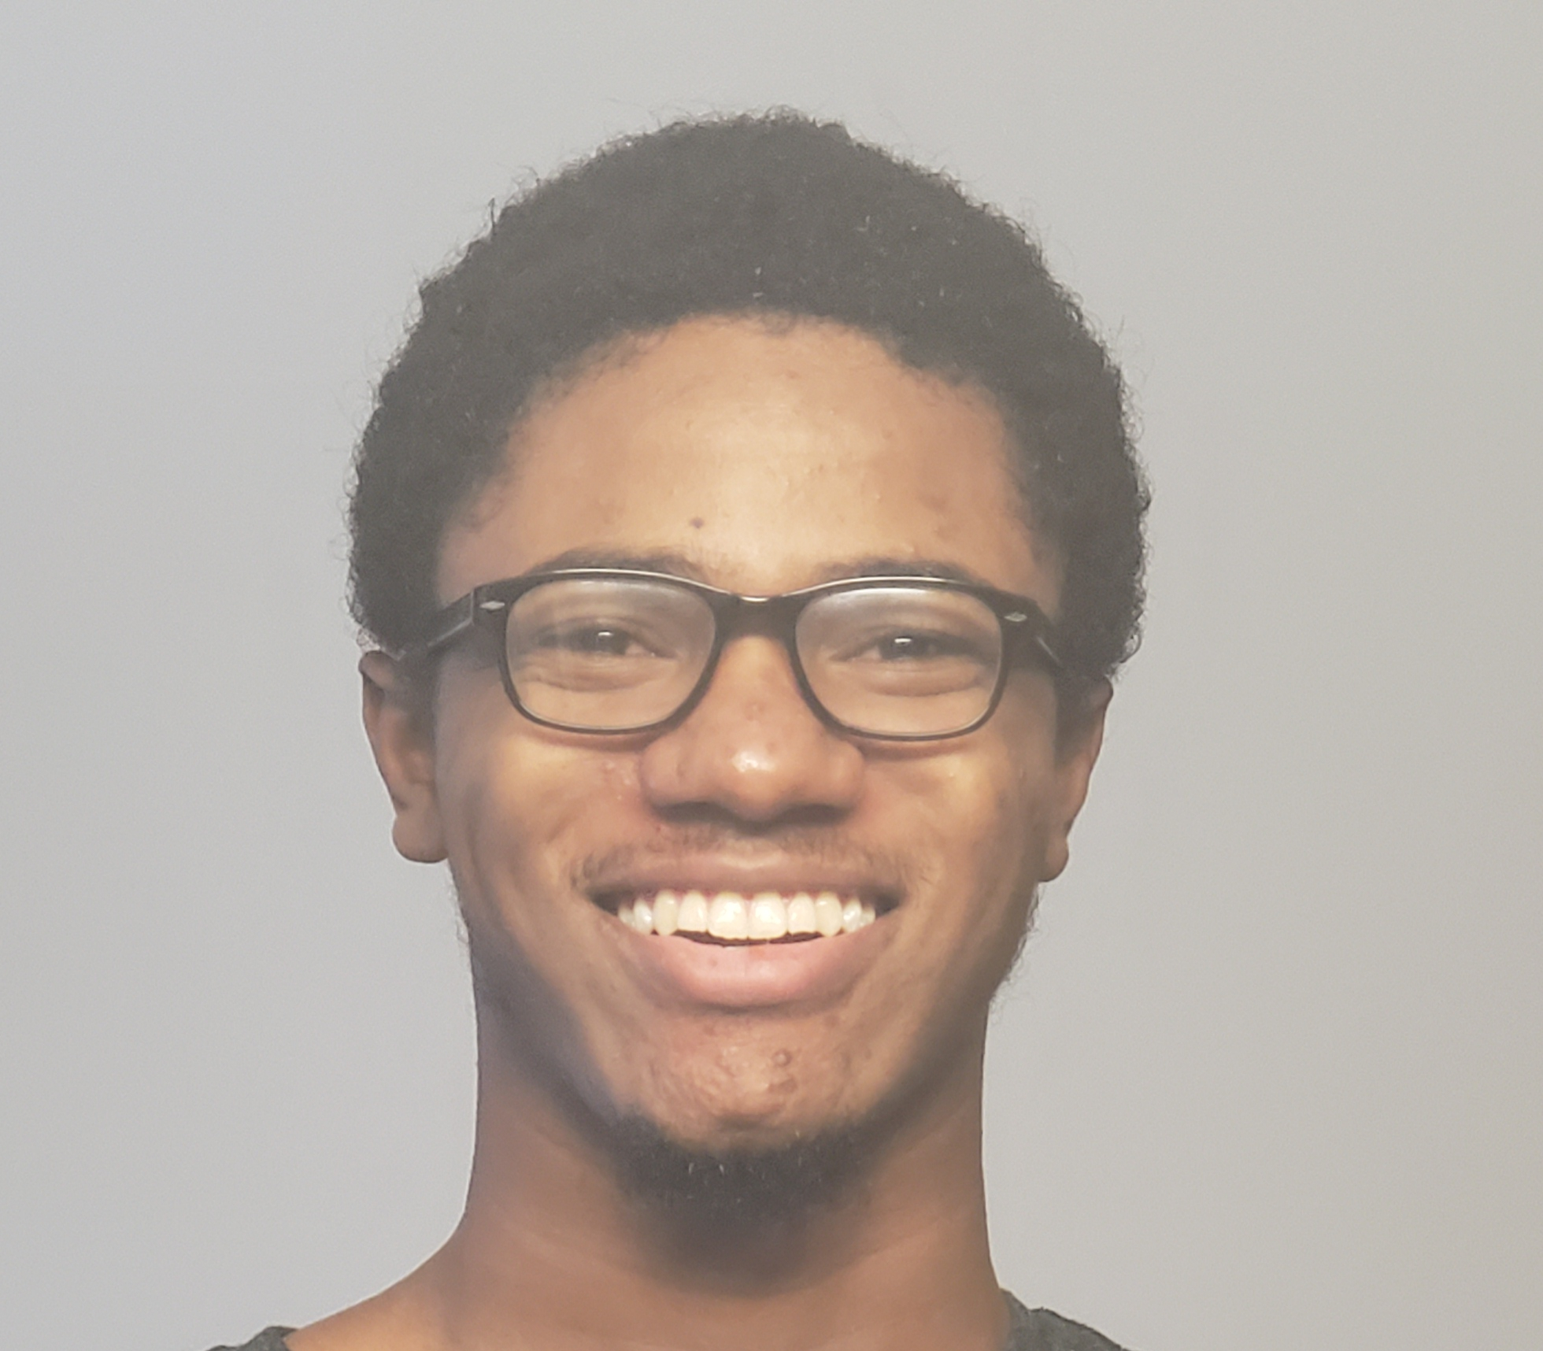
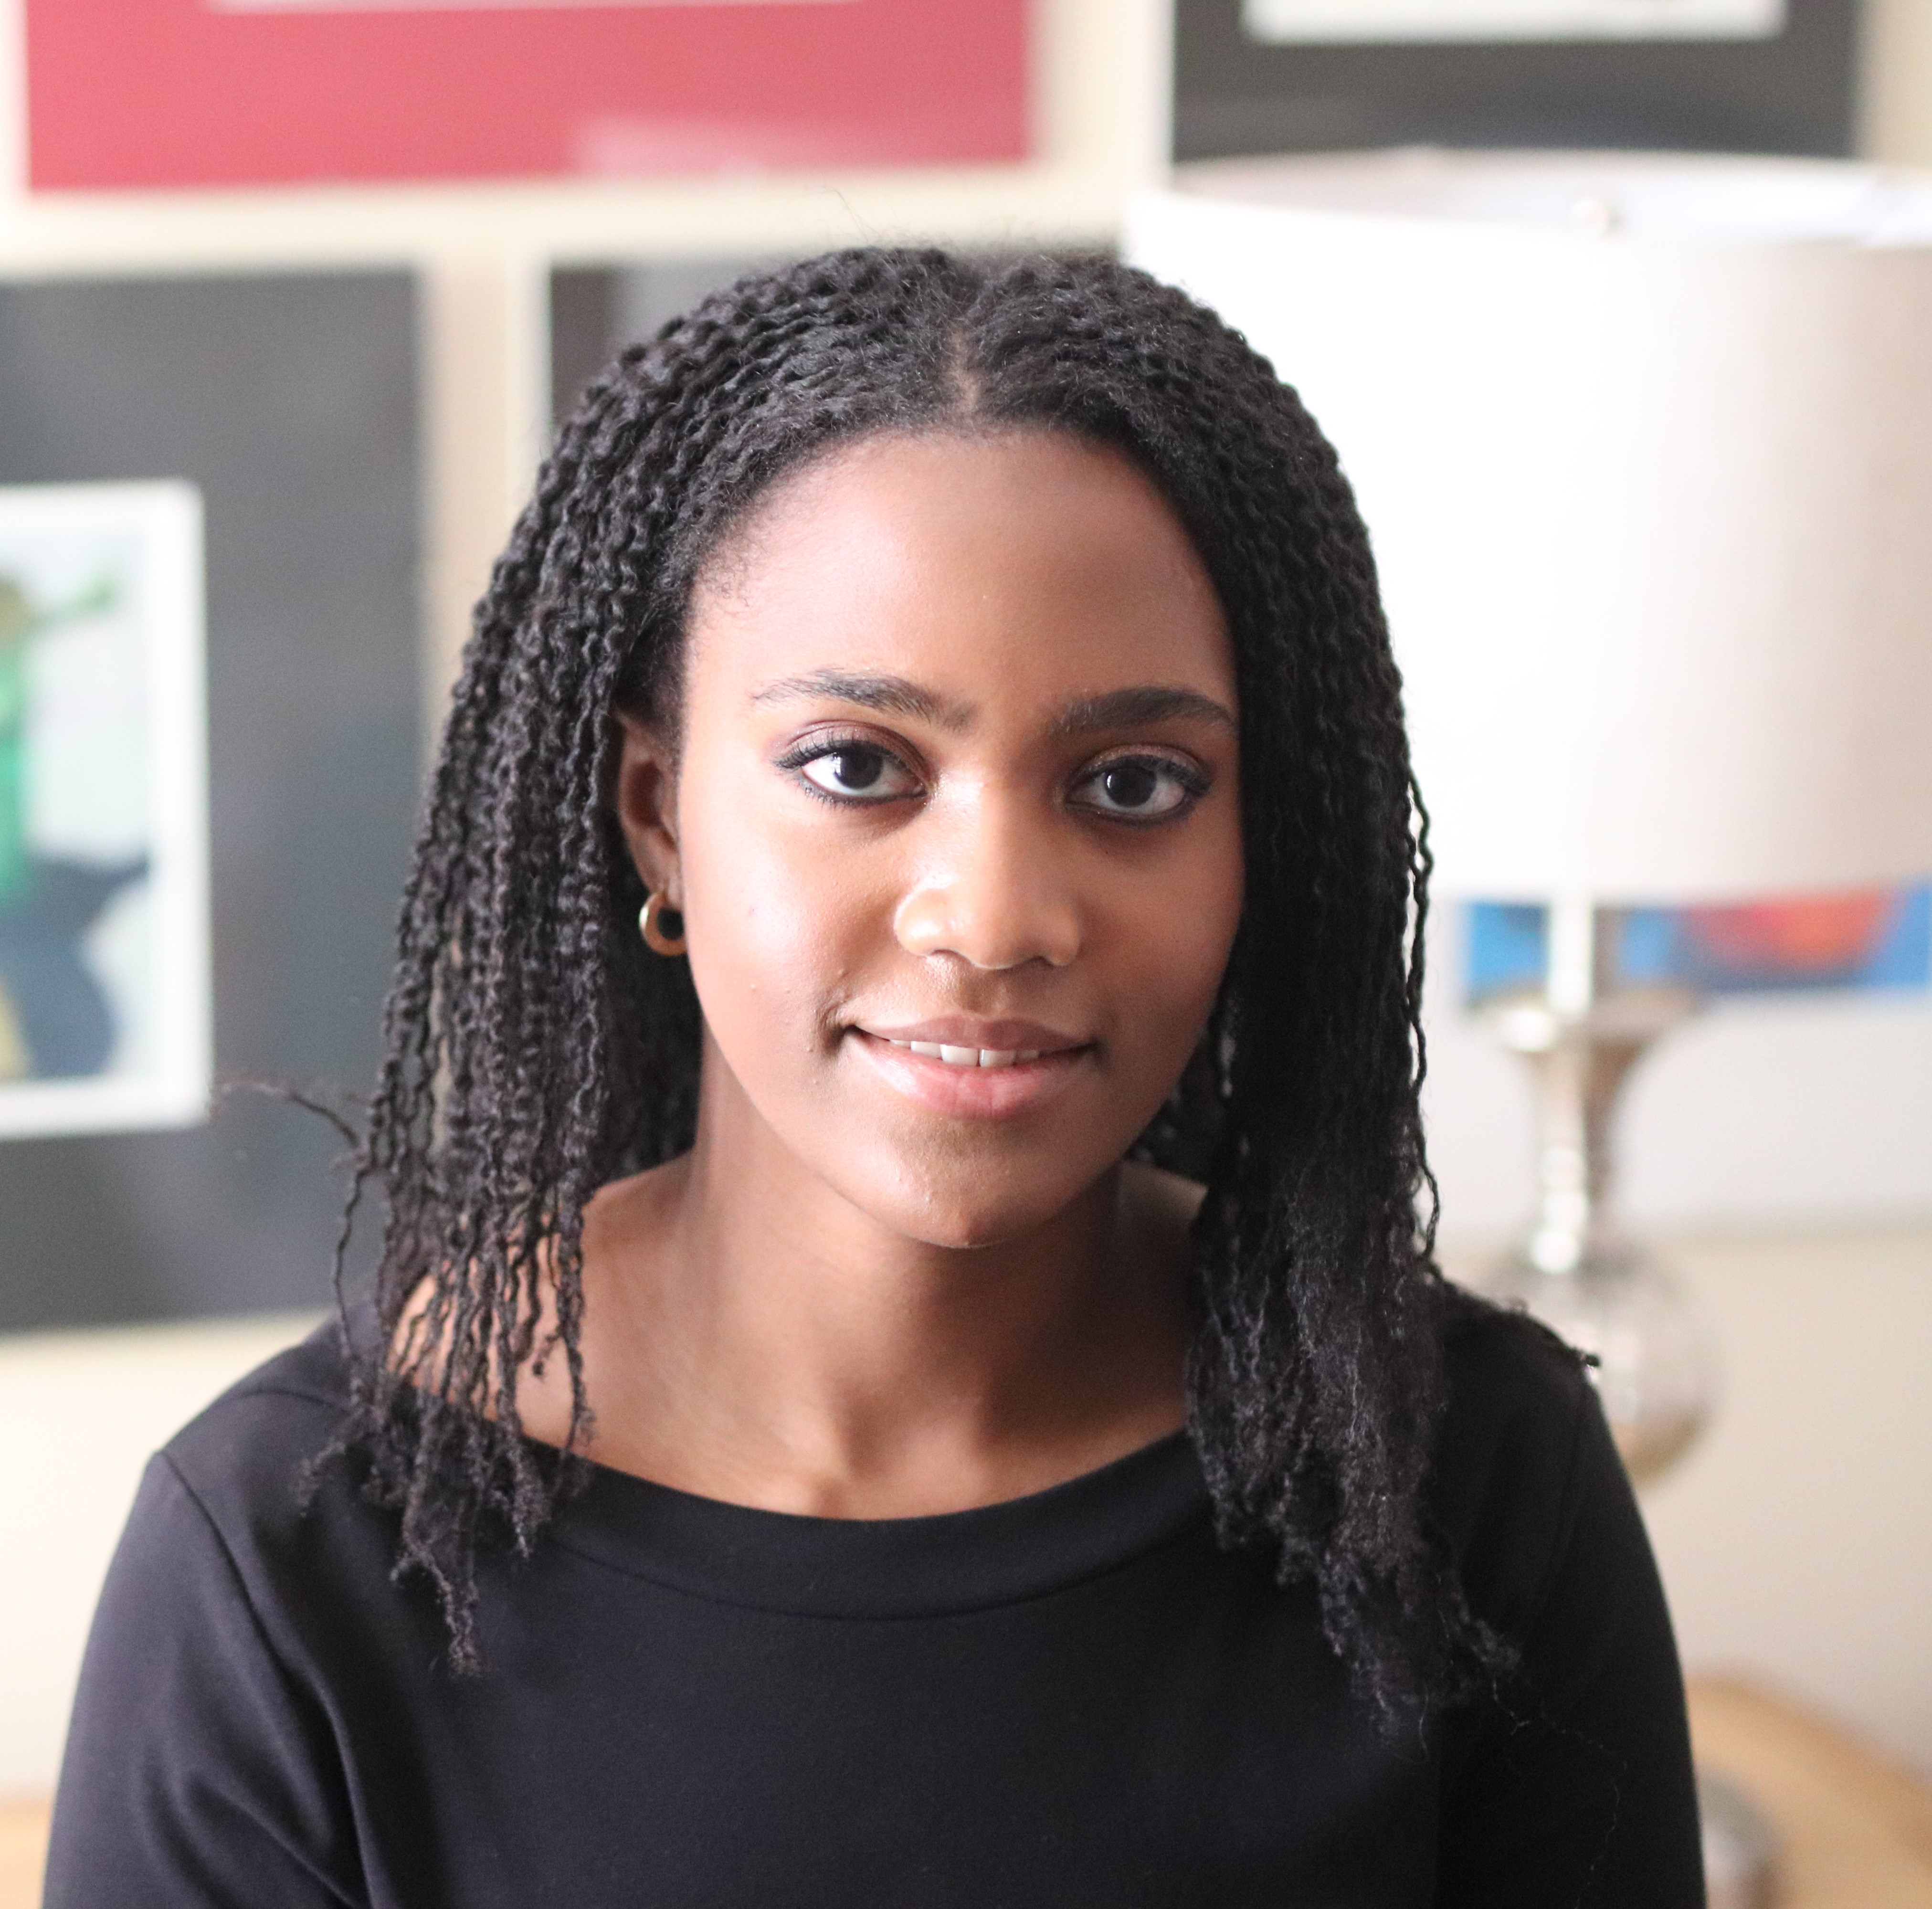

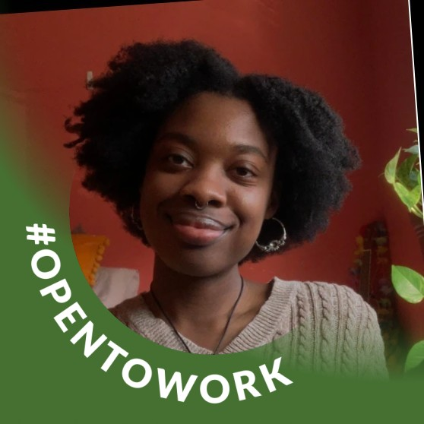

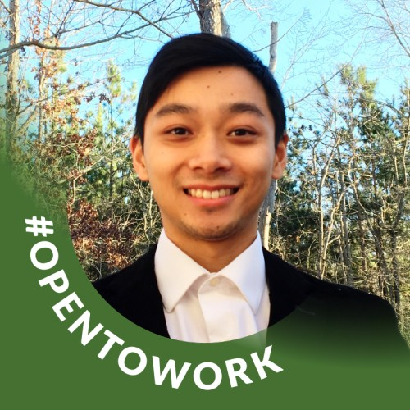




Big Thanks to the Sozzani lab !
Ross Sozzani
Fin Amin
Maimouna Abderamane Tahir
Aitch Hunt
Matthew Murray
Postdocs
Graduate Students
Imani Madison
Sahil Palarpwar
Mariah Gobble
Jasmine Peace
Research Assistants
Undergraduate Students
Julie Nolan
Thomas Nguyen

